Slide 1
House Price Prediction
GROUP MEMBERS
Aleena binoy
Archana Vijayan
Bhavneet
Namita
Sharan Sara Shaji

Slide 2
Content
Introduction
Data Collection And Preparation
Visualization
Methodology
Model training and Evaluation
Model Predictions
Discussion
Conclusion

Slide 3
Introduction
Problem Statement:
Predict house prices in Boston using advanced regression techniques.
Objective:
The primary objective was to provide significant insights into the real estate market through thorough data analysis and predictive modeling techniques.
Aim:
Gain insights into the real estate market.
Provide accurate predictions of housing values.

Slide 4
Significance:
Critical for informed financial decisions.
Offers insights into economic and societal trends.
Utilizes advanced regression for nuanced modeling.
Relevance:
Adapts to dynamic real estate markets.
Addresses growing demand for predictive analytics.
Advances knowledge in machine learning and real estate economics.

Slide 5
Data Collection and Preparation:
Dataset Description:
Sourced from Kaggle, a platform for data science competitions and datasets.
Contains features related to housing characteristics in Boston.
Includes variables such as housing prices, crime rates, demographics, and proximity to amenities.
Structured as a tabular dataset with rows representing individual properties and columns representing features.
Used for training and testing regression models to predict housing prices.

Slide 6
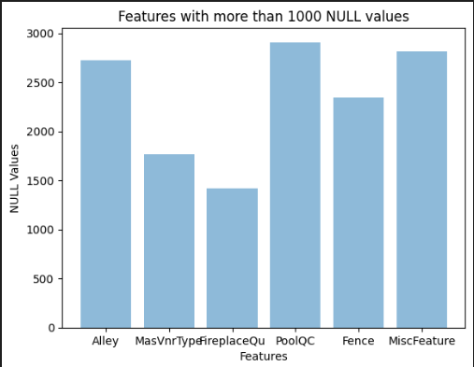
Data Collection and Preparation:
Data Loading and Concatenation:
Loaded train and test data from the provided CSV files.
Concatenated both datasets to form a single DataFrame for analysis.
Handling Missing Values:
Visualizes features with more than 1000 Null values in the dataset using python
Dropped columns with more than 1000 NULL values using the ‘dropna’ method
Select numerical columns: Only columns containing numerical data are selected using the ‘select_dtypes’method with the include parameter set to ‘number’.
Replaced NaN values in numerical columns with the mean.

Slide 7
Data Collection and Preparation:
Feature Engineering:
Encoding: Converting categorical variables into numerical representations using one-hot encoding
Drop features that are highly correlated with each other
Calculate the covariance matrix using the ‘corr()’ method.
Identify highly correlated features.
Drop Correlated features from the dataset using the ‘drop()’ method along the columns.
By dropping highly correlated features, we reduce redundancy and potentially improve the performance and interpretability of the model.

Slide 8
Data Collection and Preparation:
Drop features that are highly non-correlated:
Identifying Non-correlated Features:Features with an absolute correlation coefficient less than 0.045 (adjustable threshold) are considered non-correlated with the output.
Drop Unnecessary Features.
Optimization for Model Performance: By removing non-correlated features, you're optimizing your dataset for better model performance

Slide 9
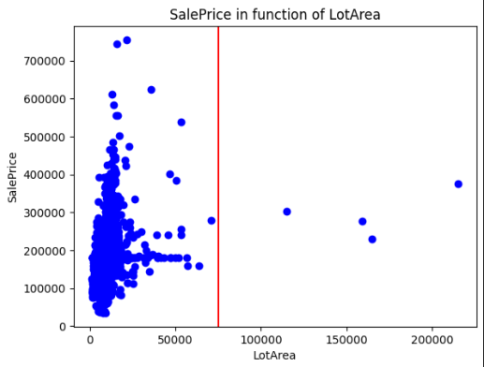
Visualization
Generates a scatter plot to visualize the relationship between the 'LotArea' feature and the ‘SalePrice' target variable.
The scatter plot shows the distribution of 'SalePrice' against 'LotArea’.
An outlier detection mechanism is implemented by drawing a red vertical line at a specific 'LotArea' value of 75,000
The plot allows viewers to assess whether there are any noticeable patterns or trends between 'LotArea' and 'SalePrice’.

Slide 10
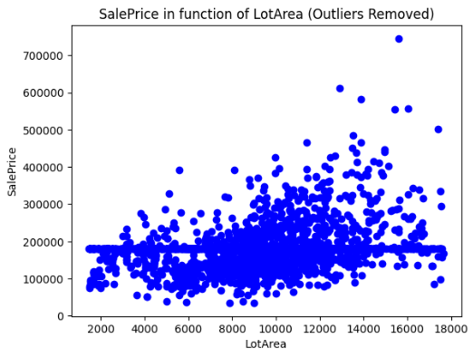
Outlier Removal using Interquartile Range (IQR) Method
The plot illustrates the relationship between 'LotArea' and 'SalePrice' after removing outliers, providing a clearer understanding of the data distribution.

Slide 11
Methodology:
Algorithms Employed:
Linear Regression: Baseline model for predicting house prices based on linear relationships between features.
Random Forest Regressor: Ensemble learning technique that constructs multiple decision trees and aggregates their predictions for improved accuracy.

Slide 12
Methodology:
Justification for Chosen Methods:
Linear Regression:
Simple and interpretable: Provides a clear understanding of the relationship between independent and dependent variables.
Baseline model: Serves as a benchmark against which more complex models can be compared.
Assumption of linearity: Useful for capturing linear relationships between predictors and house prices.
Random Forest Regression:
Non-linear relationships: Capable of capturing complex non-linear relationships between features and target variable.
Robustness to outliers: Less sensitive to outliers compared to linear regression, making it suitable for datasets with noisy or irregular data points.
Ensemble learning: Aggregates multiple decision trees to reduce overfitting and improve generalization performance.

Slide 13
Model Training
Data Splitting: The dataset is split into features (X) and the target variable (Y), and further divided into training and testing sets using the train_test_split function from sklearn.model_selection.
Model Training: Linear Regression and Random Forest Regression models are trained on the training data using fit() method.
Prediction: The trained models are then used to make predictions on the test set (X_test).
Evaluation Metrics: Various evaluation metrics, including MSE, R^2, and Explained Variance, are calculated for each model's predictions compared to the actual target values (Y_test).
Comparison: Compared model performance based on evaluation metrics.

Slide 14
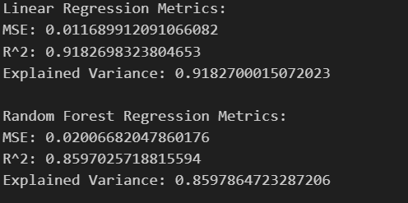
EVALUATION
The output of the evaluation suggests that for the given dataset and metrics:
Linear Regression performs better in terms of MSE.
Linear Regression performs better in terms of R^2 and Explained Variance.
This suggests that the Linear Regression model might be better suited for this prediction task based on these evaluation metrics.

Slide 15
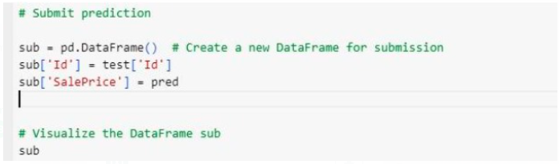
Model Predictions
Prediction:
The regression model predicts the sale prices ('SalePrice') for the test dataset using the 'predict' method.
Submission DataFrame:
A new DataFrame named 'sub' is created to store the predictions for submission. It consists of two columns: 'Id', which contains the identifiers for each data point in the test dataset, and 'SalePrice', which contains the predicted sale prices.
Visualization:
The 'sub' DataFrame is displayed to visualize the predictions along with their corresponding identifiers.

Slide 16
Discussion
Implications:
The predictions can be used by stakeholders, such as real estate agents or homeowners, to make informed decisions about pricing, buying, or selling properties.
Additionally, insights gained from the prediction process can inform future modeling efforts and improve the accuracy of predictions over time.
Limitations:
Data Quality: Potential inaccuracies or missing data in the dataset may impact the reliability of predictions.
Model Assumptions: Assumptions of linearity and independence in regression models may not hold true in real-world scenarios, affecting model performance.
Generalizability: Findings may be specific to the Boston housing market and may not be applicable to other regions or time periods.
External Factors: Unforeseen external factors, such as economic shocks or policy changes, may influence housing market dynamics, leading to prediction errors.

Slide 17
Discussion
Potential Areas for Future Research:
Incorporating additional data sources, such as demographic data or real-time market information, to improve model accuracy and robustness.
Exploring alternative modeling techniques, such as neural networks or spatial analysis methods, to capture complex relationships and spatial dependencies in housing data.
Conducting longitudinal studies to analyze trends and changes in housing market dynamics over time, providing insights into long-term patterns and cycles.
Investigating the impact of emerging trends, such as sustainable development or smart city initiatives, on housing market dynamics and property values.

Slide 18
Conclusion
Key Findings:
Identified significant predictors of house prices, including location, property size, and neighborhood characteristics.
Observed both linear and non-linear relationships between predictors and house prices, reflecting the complexity of the housing market.
Contributions:
Provided actionable insights for real estate stakeholders, such as buyers, sellers, and investors, to make informed decisions about property transactions.
Developed predictive models capable of forecasting future housing market trends, aiding in strategic planning and investment decisions.

Slide 19
Conclusion
Project Experience Reflections:
Collaborative Effort
Technical Challenges
Real-world Application
Hands-on Learning
Lessons Learned:
Importance of Data Quality
Model Interpretability
Model Selection
Ethical Considerations

Slide 20
References
Kaggle. (n.d.). House Prices: Advanced Regression Techniques. Retrieved from: https://www.kaggle.com/c/house-prices-advanced-regression-techniques
Friedman, J. H. (2001). Greedy function approximation: A gradient boosting machine. Annals of Statistics, 29(5), 1189-1232.
McKinney, W., & others. (2017). Python for Data Analysis: Data Wrangling with Pandas, NumPy, and IPython. O'Reilly Media.
Boston University. (n.d.). Boston Housing Dataset. Retrieved from: https://www.cs.toronto.edu/~delve/data/boston/bostonDetail.html

